Slide 1
Speech to Text Conversion and Classification B9AI109_2122_TMD3: NATURAL LANGUAGE PROCESSING.
By Kenneth Dsilva (10600644)and Sunil Gauda (10595858)

Slide 2
What we will cover
Process
Audio Processing
Speech To Text Conversion
Text Overview
Modelling using Supervised and Unsupervised Approach
Deployment
Conclusion

Slide 3
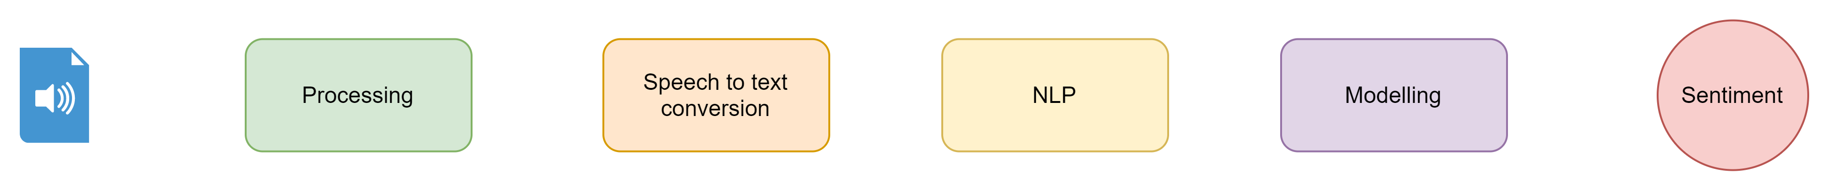
Process
Steps Included
Recording Audio – PyAudio
Processing Audio – PyAudio
Speech To text Conversion – Google API
NLP – NLTK
Modelling – Logistic Regression vs K-Means
Sentiment – Happy / Sad

Slide 4
Audio Processing
Steps
Setting Audio Parameters
Record Audio Stream
Analyse

Slide 5
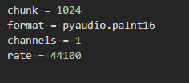
Setting Audio Parameters
Params
Chunk
Format
Channels
Rate

Slide 6

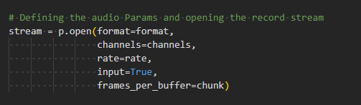
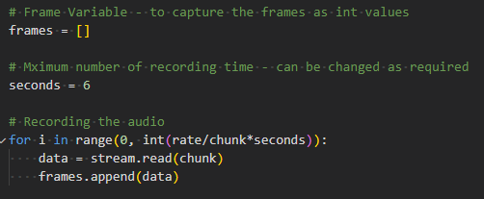
Recording Audio
Process
PyAudio Instance
Add Params and start recording
Stop Recording and save the stream as int

Slide 7

Analyse
Recorded Audio Parameters

Slide 8
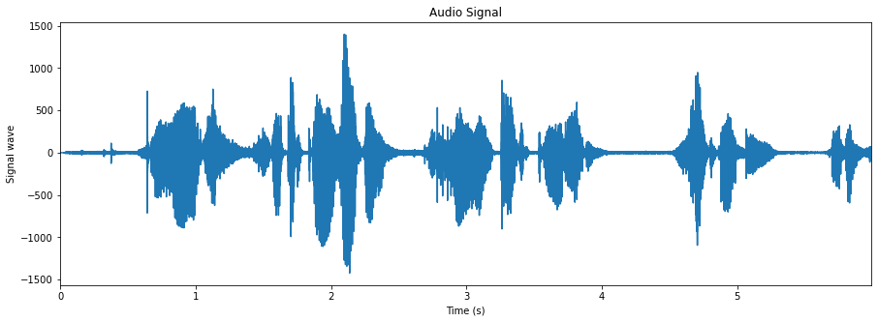
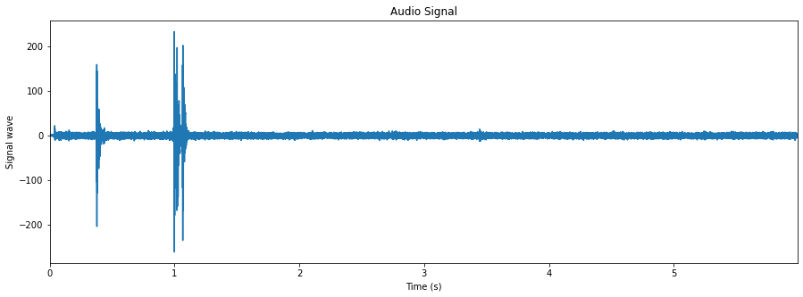
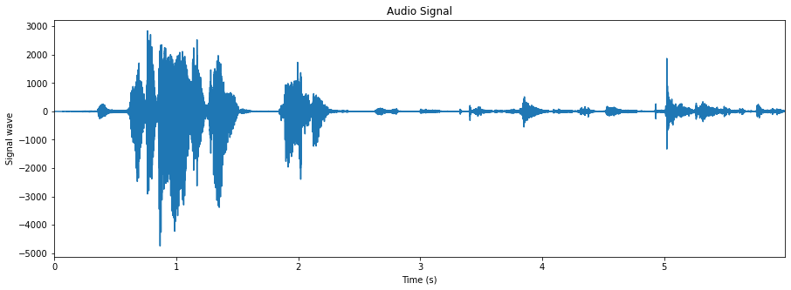
Analyse - Visualize Audio
Speech Audio
Empty Audio
Recorded Audio

Slide 9
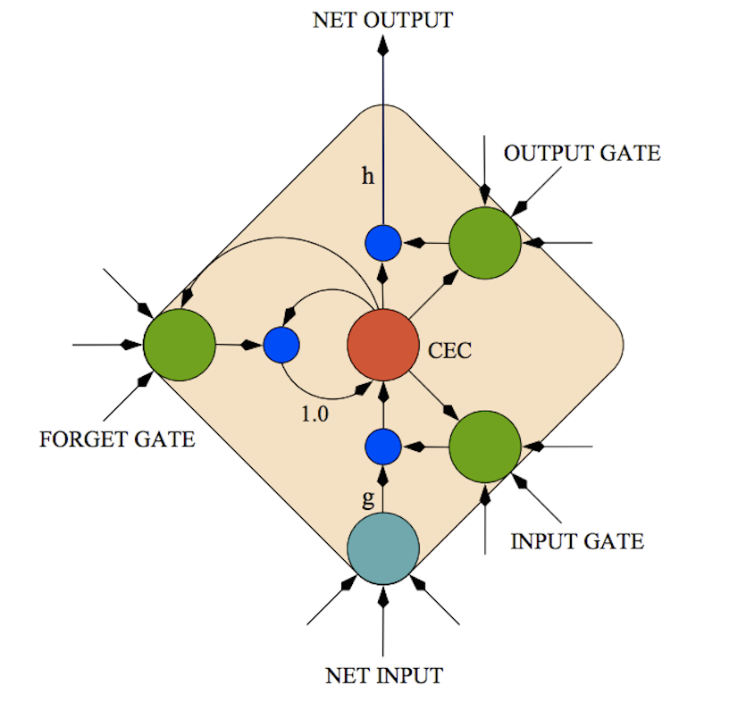
Speech To Text
Google Speech to Text Architecture

Slide 10
Speech To Text
Language Modelling
DNN - 2009
GMM - 2012
LSTM - Current

Slide 11
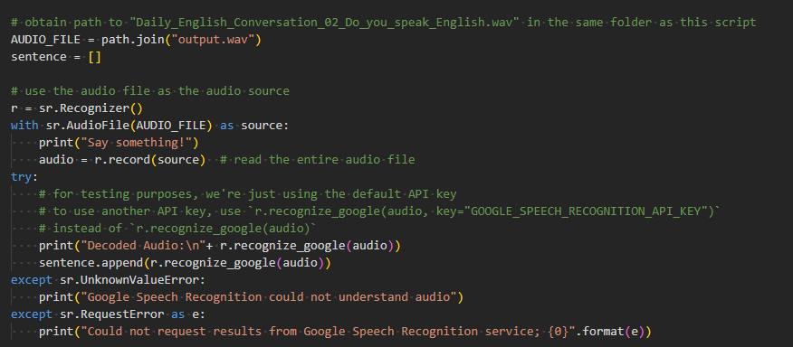

Speech To Text
Implementation
Output

Slide 12

Text Overview
Visualizing the Text Received from API

Slide 13
Modelling using Supervised and Unsupervised Approach
Supervised
Trained on One of the Datasets, Yelp, Amazon, IMDB
Labels available as 0 / 1
Only Vectorization is needed
Model Trained
Un - Supervised
Need to be trained on a dictionary, so combined dataset of Amazon, IMDB, Yelp is used
Labels are not required so it is not used
Cleaned data using NLTK
Scored Sentiments "vader_lexicon" and "SentimentIntensityAnalyzer"
Model Trained

Slide 14
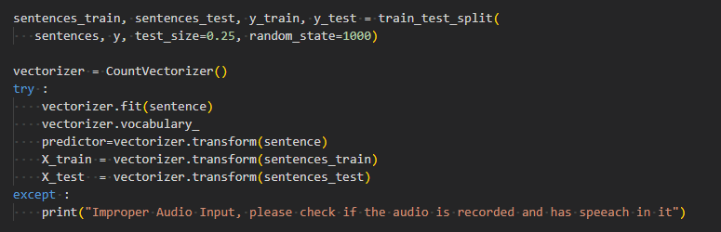
Modelling using Supervised and Unsupervised Approach
Supervised
Preparing the Dataset

Slide 15
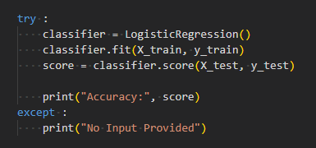
Modelling using Supervised and Unsupervised Approach
Supervised
Creating the Model

Slide 16
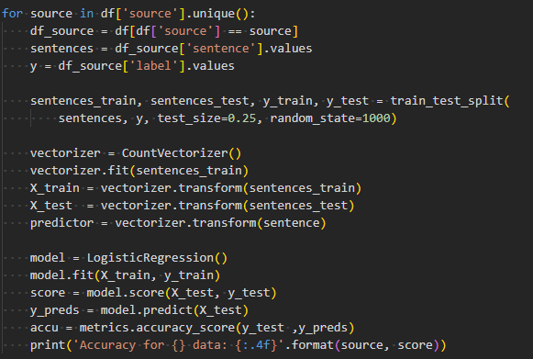

Modelling using Supervised and Unsupervised Approach
Supervised
Training and Evaluating

Slide 17
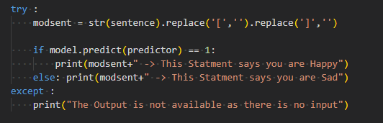
Modelling using Supervised and Unsupervised Approach
Supervised
Finalizing The Model

Slide 18
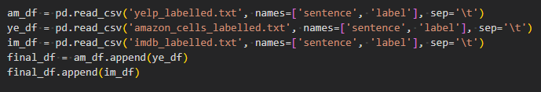
Modelling using Supervised and Unsupervised Approach
Un-Supervised
Preparing the Dictionary

Slide 19

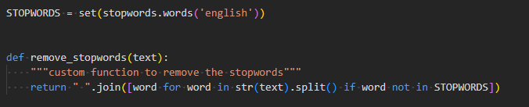

Modelling using Supervised and Unsupervised Approach
Un-Supervised
Stop words

Slide 20

Modelling using Supervised and Unsupervised Approach
Un-Supervised
Vectorizer

Slide 21
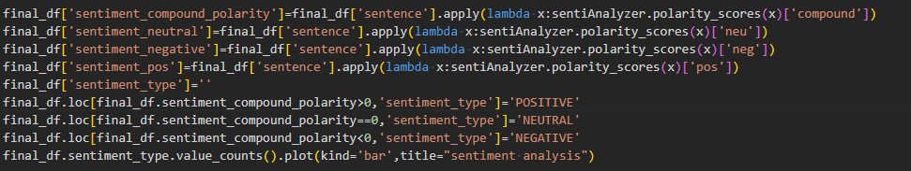
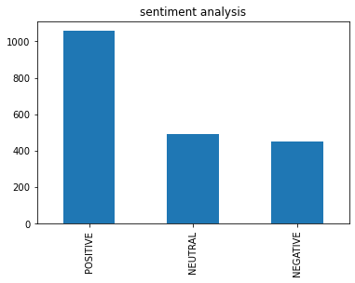
Modelling using Supervised and Unsupervised Approach
Un-Supervised
Sentiment Score

Slide 22
Modelling using Supervised and Unsupervised Approach
Un-Supervised
Sentiment Score Distribution

Slide 23
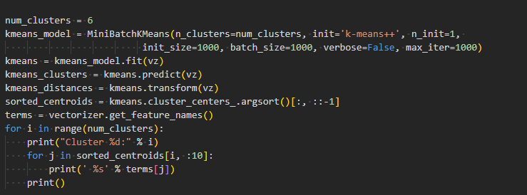
Modelling using Supervised and Unsupervised Approach
Un-Supervised
K-Means

Slide 24
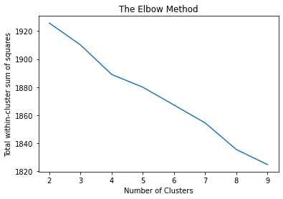
Modelling using Supervised and Unsupervised Approach
Un-Supervised
N-Clusters – Elbow method

Slide 25
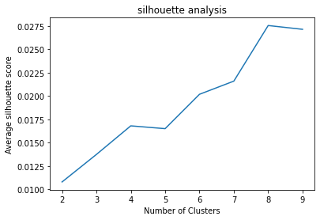
Modelling using Supervised and Unsupervised Approach
Un-Supervised
N-Clusters – silhouette score

Slide 26
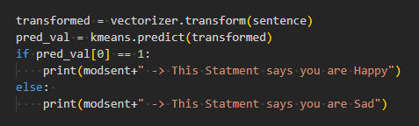
Modelling using Supervised and Unsupervised Approach
Un-Supervised
Prediction

Slide 27
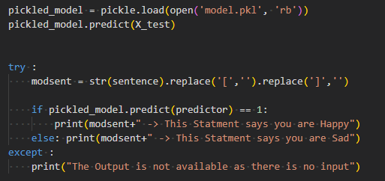

Deployment
Pickle
Save
Load

Slide 28
Deployment
Options
Pickle Model – Server Web
Cloud Platforms

Slide 29
Conclusion
We would like to conclude with the observation that using the Google API we can easily convert a speech of less than 6- seconds to words and using both Supervised and Unsupervised Techniques we can easily convert these words detected to reflect the speaker's emotion of sadness or happiness.

Slide 30
Thankyou

